Slide 1
Case Study
Lonnie-Monique Jasper

Slide 2
Descriptions
Ms. Jasper
“Will”
The Art Room

Slide 3
Ms. Jasper
Mixed woman in mid twenties
Has preschool aged son; single mother
Raised by both parents in quiet neighborhood
Has five siblings
Art teacher and artist
Focuses on building positive relationships with students
Sometimes approaches situations with “mom” mindset
Has to remind herself that kids are not being brought up the way she was (yes ma’am, no sir, disciplined for bad behavior, etc.)

Slide 4
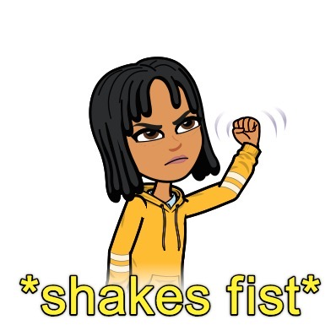
“Will”
Mixed male student in third grade
Mother passed away, raised by father; father is “menace”
Did not start school until first grade- did not know “school etiquette/procedures”
Has younger brother
Very talented artist
Very defiant student
Has mindset that “everyone is against him”

Slide 5
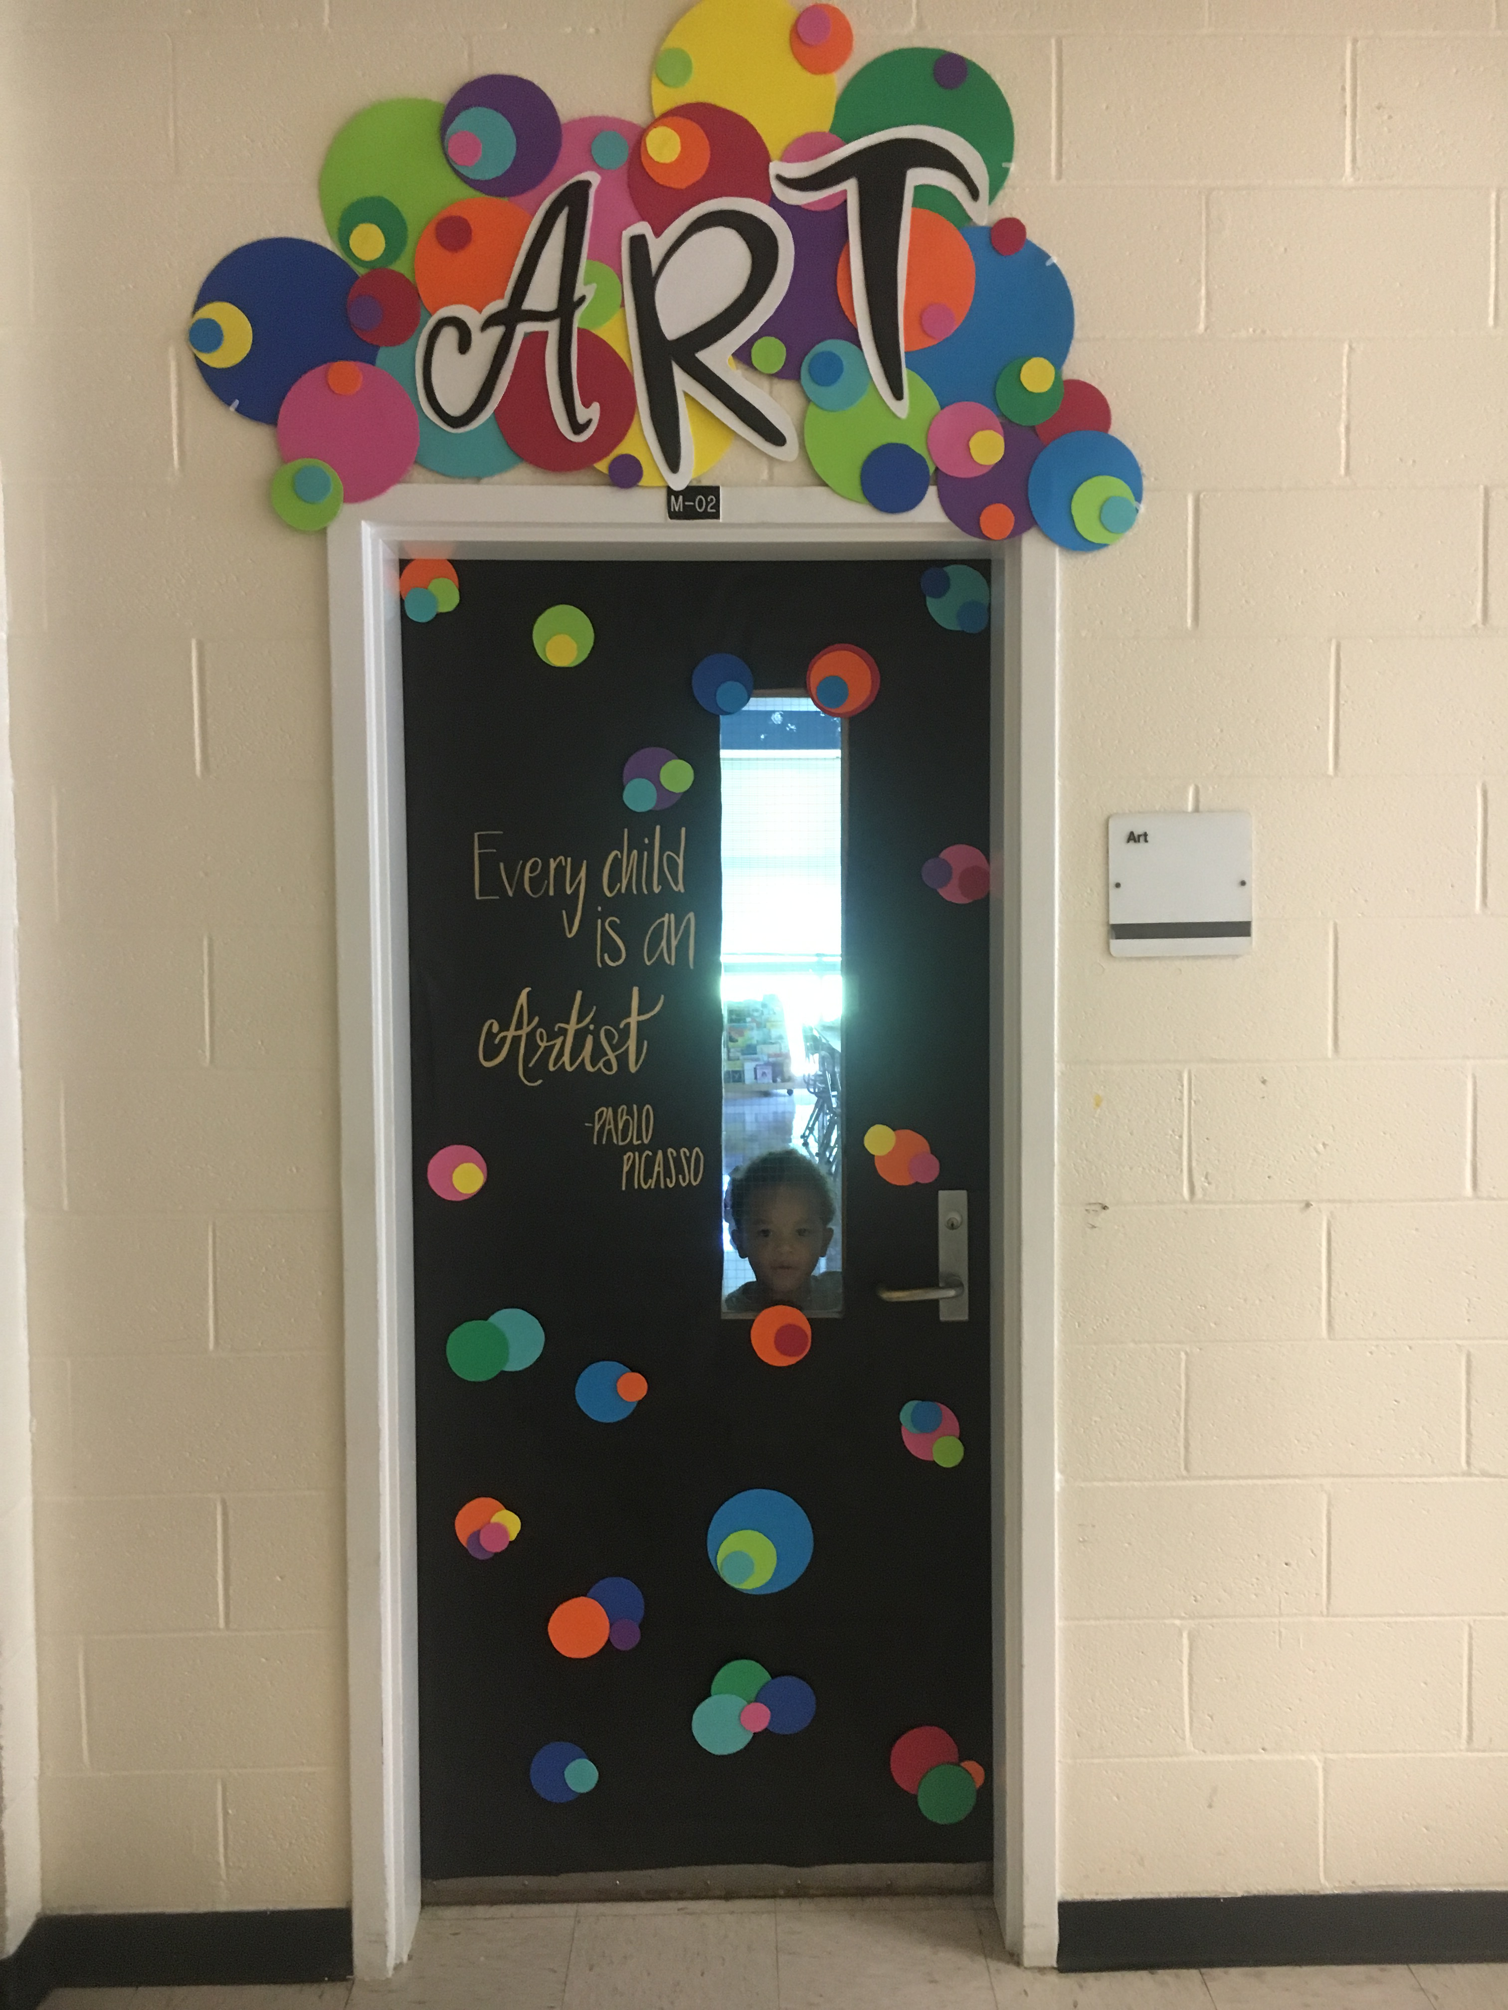
Environment
Art Room
Very clean space
Bright and inviting
Teacher greets with a smile
Teacher has open discussions with
students to get to know them better
and build relationships
Fun art projects

Slide 6
The Case
Before
During
After

Slide 7
Before
Will did not know proper school etiquette and procedures
Examples: how to sit still in class, wait turn to talk, no profanity in school, walk in line
Will was very sweet and helpful
Minimal parent contact because Will worked hard to learn how to properly behave in school

Slide 8
During
Will suddenly started becoming very defiant with teachers
Continuous arguing with students and teachers
Damaging materials in art class
Ended up with administration almost every art class period
Could not call father because father would escalate situation and blame teachers
Ms. Jasper continuously fussing to get Will to behave in art class

Slide 9
After
Ms. Jasper did self reflecting
She applied knowledge acquired in classes
Approached with a “Love and Logic” mindset
Found ways to accommodate Will’s behavior to prevent him from disrupting students and class
Ms. Jasper made Will her helper
Will and Ms. Jasper began building a sturdy relationship
Will did not have to continuously go to time-out
Will was able to complete art projects and become one of the top artists

Slide 10
Reflection
Looking back I handled the situation poorly
I would be annoyed when I saw Will and if he asked to go somewhere other than my class I would gladly let him leave
I would argue with him sometimes and constantly fuss and it took away from the other students’ art time
I pegged Will as a horrible student with no chance of success and was upset because he did have talent that he refused to apply and I refused to nurture that talent because I hated his behavior

Slide 11
Reflection
Part of his behavior was my fault
I was an “on the whim” teacher without any clear plans
I neglected the information I learned about using love and logic in the classroom
Although my class knew what I expected behavior wise, I honestly did not have proper classroom management skills

Slide 12
If I knew then what I know now….
Wong’s article explains that classroom management is everything the teacher does to organize students, space, time, and materials so that student learning can take place
I HAD ABSOLUTLEY NO CLASSROOM MANAGEMENT
I lacked organization in every aspect and I also lacked consistency.
I had a great relationship with my students and I had minimal behavior problems besides Will but there was nothing organized about my lessons or how my classroom functioned

Slide 13
If I knew then what I know now…
One of the most important gifts we can give our students is to be consistent and predictable- Henry Wong
Will’s home life was volatile and unstable, I failed to provide him with consistency and stability because I would take his behavior to heart

Slide 14
In the future…
My time with Will was cut short and sadly I won’t see him anymore but if I ever encounter another student like Will, I’ll know a few things from my coursework to help me out
I’ll keep in mind to provide consistency and predictably to my students as described by Wong
I’ll also know to remember the Five Standards of Effective Pedagogy

Slide 15
The Five Standards of Effective Pedagogy
Joint productive activity
Language development
Contextualization
Challenging activities
Instructional conversation

Slide 16
Beliefs and Values
My belief is that every student has the potential for greatness as long as they have someone in their life to nurture and help that greatness grow
Everyone deserves to be treated with love and respect
Provide a loving and inviting environment
Apologize when necessary

Slide 17
Beliefs and Values
Will believed that everyone was against him and that no one loved him
He decided to act out in class for attention even if it was negative attention
He felt like he was the boss
He learned that there are rules and consequences for his behaviors

Slide 18
Beliefs and Values
My students know that I love them and we value our relationship
I believe that they are all artists and they believe it too
I communicate to my students that I love them no matter what
I motivate them by reinforcing that arists are not perfect, they always do their best and that’s what I expect
I redirect students by asking them what is the right thing to do, a method I learned from Love and Logic

Slide 19
Resources
Five Standards of Effective Pedagogy. (2019). Teaching Tolerance. Retrieved from https://www.tolerance.org/print/66236
Wong,H., Womg, R., Rogers, K., & Brooks, A. (2012). Managing your Classroom for Success. Retrieved from https://www.jstor.org/stable/43747385

